Slide 1
Modeling the pandemic – Introduction to scientific modeling
This course is about epidemic modeling, but before we dive into that, let’s take a step back and ask a few more general questions
What is a scientific model?
What is the relationship between scientific theories and models?
What are data and how do scientific models relate to them?
How are scientific models tested and what makes them good or bad?

Slide 2
Modeling the pandemic – Introduction to scientific modeling
What is a scientific model?
Typically a set of mathematical equations or a computer program that allows you to make inferences about a target of interest
For instance, it can be used to make quantitative or qualitative predictions
There can always be many different models even the same target

Slide 3
Modeling the pandemic – Introduction to scientific modeling
Scientific models always involve idealizations, which are departures from reality
Aristotelian idealizations: stripping away of irrelevant (for current purposes) properties (e. g. planets have a mean surface temperature, but we ignore it when calculating orbits)
Galilean idealizations: introducing distortions relative to reality (e. g. assuming the string of a pendulum is massless)
“All models are wrong, but some are useful.” (George E. P. Box)

Slide 4
Modeling the pandemic – Introduction to scientific modeling
Models rely on idealizations for several different reasons
To make the model mathematically/computationally tractable
Because depending on what you want to use the model for, some aspects of reality are not going to be relevant
What idealizations you make depend on various factors such as what you want to use the model for, what kind of computational power you have at your disposal, etc.

Slide 5
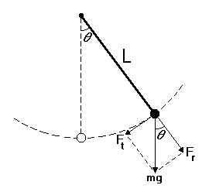
Modeling the pandemic – Introduction to scientific modeling
Example: the simple gravity pendulum

Slide 6
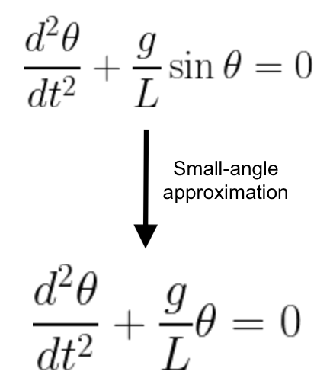
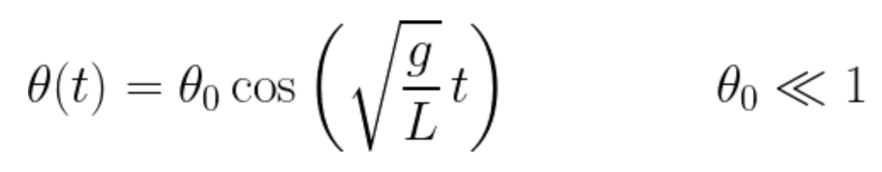
Modeling the pandemic – Introduction to scientific modeling

Slide 7
Modeling the pandemic – Introduction to scientific modeling
This model is no good if you want to predict the motion of a real pendulum because it’s unrealistic
For instance, in reality, there is friction so the motion doesn’t continue indefinitely
However, if you just want to understand how gravity can produce oscillating motion, it’s pretty good
For another purpose, you may have to introduce a dampening term in the model, to account for friction

Slide 8
Modeling the pandemic – Introduction to scientific modeling
Models and theory
“Models as mediators”: theory can’t be used directly to make inferences about systems, you must first create a model, which is derived from theory but not only
The simple gravity pendulum also illustrates the relationship between models and theory
The equations were derived from fundamental laws of nature, but not only
Some assumptions were made about the physical setup, mathematical approximations were used, etc.
Similar for other, more complicated scientific models, but different scientific models are more or less directly related to theory

Slide 9
Modeling the pandemic – Introduction to scientific modeling
What are data?
People often think of data as “given” to scientists
On this view, models and theories are tested against data that is given “from the outside”
If the model or theory is consistent with the data, we say that it’s supported by the data, otherwise it’s falsified

Slide 10
Modeling the pandemic – Introduction to scientific modeling
This picture is simplistic, it’s not really how things work
Data are what philosophers of science call “theory-ladden”: what data you have is affected by theoretical presuppositions
Think about the readings of a thermometers: we take them to tell us something about temperature because of theoretical considerations
Obtaining the data you need to test a model often implies relying on another model that can be even more complicated than the model you are trying to test

Slide 11
Modeling the pandemic – Introduction to scientific modeling
Example from climate science 1: records of instruments in meteorological stations, the urban heat island effect and the change in mean global surface temperature
Example from climate science 2: satellite data and changes in the mean temperature of the troposphere
These illustrates how, while people may often take data at face value, they rely on many more or less implicit theoretical assumptions and often were obtained by using models of their own

Slide 12
Modeling the pandemic – Introduction to scientific modeling
Data used for epidemic modeling
The same thing is true for data used for epidemic modeling
For instance, modelers use data on cases, but those pose several questions
We are interested in infections, not confirmed cases per se, so you have to make assumptions about how cases relate to infections
For example, data on cases are affected by “day-of-the-week effects”, so people generally smooth them before using them in modeling, but there are several ways of doing that

Slide 13
Modeling the pandemic – Introduction to scientific modeling
Another example is how long do you wait between 2 positive tests for the same person before you consider that a reinfection?
At the beginning of the pandemic, there were reports of reinfections just 1 or 2 months after the first infection in South Korea, because some people had tested positive twice in less than 2 months in South Korea
This led Jean-François Delfraissy, the head of the French Scientific Council, to say that infection didn’t confer any immunity or very little
The actual explanation is that those were false positives and Delfraissy doesn’t understand Bayes’s theorem, which we’ll examine later

Slide 14
Modeling the pandemic – Introduction to scientific modeling
Another example is data on seroprevalence
Seroprevalence is the proportion of the population that has antibodies against a pathogen, such as SARS-CoV-2, so we know they have been infected
In principle, by administering a serological test to a representative sample of the population, we can estimate what share of the population has been infected
But even if we have a truly representative sample, which is often not the case, there are many problems that make this more complicated

Slide 15
Modeling the pandemic – Introduction to scientific modeling
One problem is that serological tests can produce false positive and false negative results
False positive: someone doesn’t have antibodies against the pathogen, but the test is nevertheless positive
False negative: someone has antibodies against the pathogen, but the test is nevertheless negative
Sensitivity of test = probability that, if someone has antibodies, the test will come out positive = 1 – false negative rate = P(positive | has antibodies)
Specificity of test = probability that, if someone doesn’t have antibodies, the test will come out negative = P(negative | doesn’t have antibodies) = 1 – false positive rate = 1 – P(positive | doesn’t have antibodies)

Slide 16
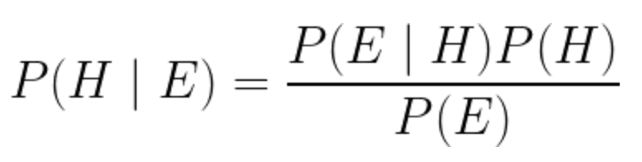
Modeling the pandemic – Introduction to scientific modeling
Bayes’s theorem

Slide 17
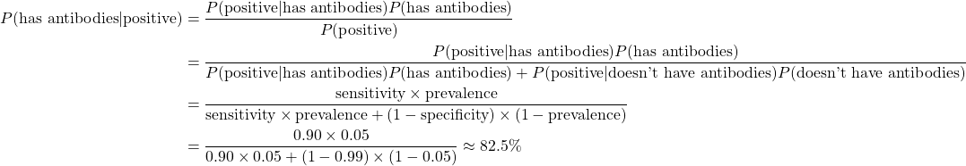
Modeling the pandemic – Introduction to scientific modeling
Suppose that prevalence = 5%, specificity = 99% and sensitivity = 90%

Slide 18

Modeling the pandemic – Introduction to scientific modeling
Suppose that prevalence = 50%, specificity = 99% and sensitivity = 90%

Slide 19
Modeling the pandemic – Introduction to scientific modeling
So whether someone really has antibodies when they tested positive depends on the actual seroprevalence
When seroprevalence is very low, as in South Korea at the beginning of the pandemic, most positive tests will be false positive (hence Delfraissy’s mistake)
But the seroprevalence is precisely what we’re trying to estimate!
The imperfect specificity and sensitivity of the test can be taken into account, but it’s not easy and people can make mistakes
At the beginning of the pandemic, some people have overestimated seroprevalence in the population, hence they underestimated the IFR, so this can be a big deal

Slide 20
Modeling the pandemic – Introduction to scientific modeling
Another problem is that, in many cases (e. g. if we’re trying to estimate the IFR), we don’t really care about what proportion of the population has antibodies per se
What we want to know is the attack rate, i. e. the proportion of the population has been infected
This is not the same thing because of antibody decay: antibody level drops over time after infection
So, in order to estimate the attack rate, you need to adjust seroprevalence to account for antibody decay, which is tricky

Slide 21
Modeling the pandemic – Introduction to scientific modeling
Implication for model testing: the Quine-Duhem thesis
One implication is that, if the predictions of the model don’t match the data, you don’t really have to reject the model
That’s because, what you are really testing is not just the model, but the model + a lot of auxiliary hypotheses, especially hypotheses about how the data relate to the phenomena of interest
So instead of rejecting the model, you could reject those hypotheses and, therefore (in the case of auxiliary hypotheses about the relationship between the data and the phenomena of interest), the data
This means that a theory/model can never really be falsified and falsifiability is not what makes a theory/model scientific

